Slide 1
Boosting Algorithm
Assignment

Slide 2
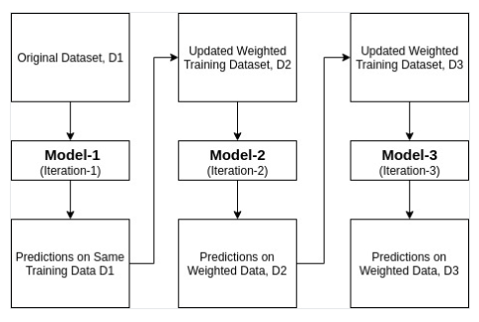
AdaBoost
- Converting number of weak learners to strong learners

Slide 3
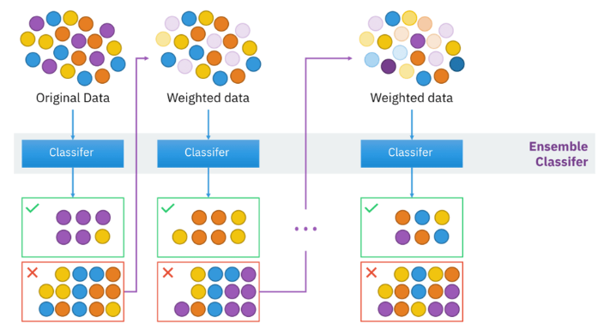
AdaBoost
- Weights are re-assigned to each instance

Slide 4
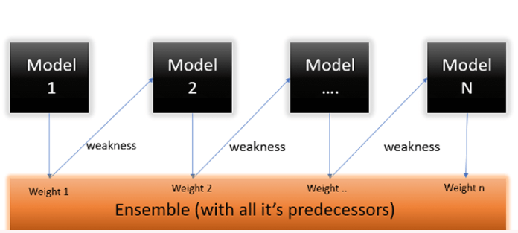
AdaBoost
- First build a model on the training dataset and then build a second model to rectify the errors present in the first model

Slide 5
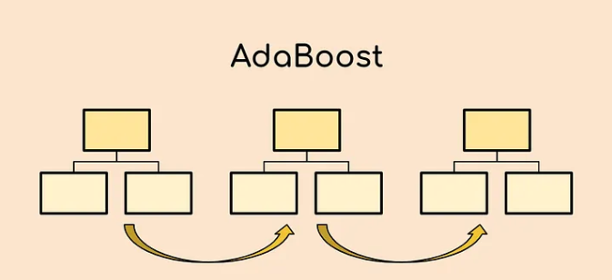
AdaBoost

Slide 6
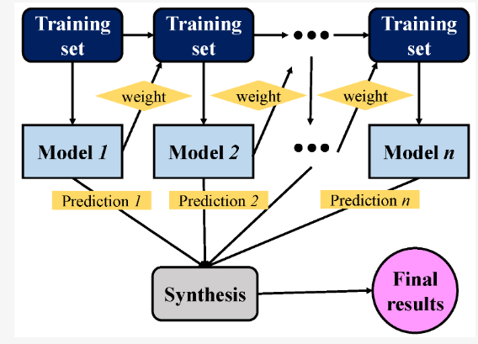
AdaBoost
- Procedure is continued until and unless the errors are minimized and the dataset is predicted correctly

